Slide 1
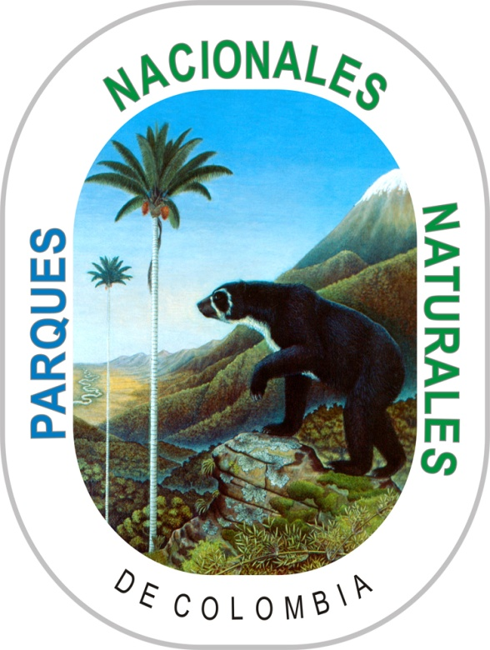

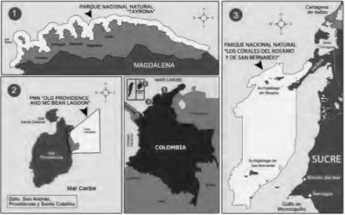
CORAL REEF CONSERVATION IN THREE PROTECTED MARINE AREAS OF THE COLOMBIAN CARIBBEAN COAST
Franke-Ante, Rebeca; Cano-Correa, Marcela; Zarza-González, Esteban; Angarita-Jiménez, Luz Elvira;
Rodriguez-Goenaga, Ludovica; Hernández-Osorio, Elizabeth; Aponte-Sierra, Carlos;
Posada-Osorio, Santiago.
Parques Nacionales Naturales de Colombia - Dirección Territorial Caribe
ABSTRACT
National Natural Parks of Colombia has undertaken a number of management strategies within the Caribbean region to promote the conservation of coral reef formations. Actions have been taken to reduce pressures through environmental education, prevention, surveillance, control and ecotourism, among others. However, due to the deterioration of the world's coral reefs, Caribbean Territorial of National Natural Parks along with Tayrona National Natural Park, Old Providence Mc Bean Lagoon National Natural Park, and Los Corales del Rosario and San Bernardo National Natural Park have formed a working group to identify and implement interventions to improve the conservation status of their reefs, over the short (rescue), medium (nursery and trasplant) and long term (research project ). As a result, successful survival are presented in the three protected areas.
METHODOLOGY
The present study was carried out in three protected marine areas of the Colombian Caribbean. The Natural Park Old Providence McBean Lagoon-caribbean Insular oceanic (1648 Ha), Natural National Park Tayrona (15000 Ha) protected area with coastal upwelling and the National Natural Park Corales del Rosario San Bernardo (120.000 Ha) which is a single area marina surrounded by islands where the influence of inland waters (dique channel) (Figure 1).
Figure 1. Marine protected areas Colombian Caribbean. (1) Tayrona National Natural Park, (2) Old Providence Mc Bean Lagoon National Natural Park and (3) Los Corales del Rosario and San Bernardo National Natural Park.
Rescue of reproductive mother colonies: the activity consists of the rescue of coral colonies affected or at risk by human activities (i.e stranding of boats, repair of springs, damage by propellers and anchors) and extreme natural events (i.e, sea of cam, accretion Coastal areas) by moving the colonies or fragments of coral colonies to a coral reef center (CRC) where they are maintained to monitor their recovery, and then transplanted again in equivalent zones in terms of reef zoning and geographic location.
Nursery of corals: from 2010 the assembly of coral nurseries in the protected marine areas was carried out for the propagation by fragmentation of different species of coral. The nurseries currently implemented are lineal, domes and coral tree, where coral colonies are maintained until the moment of transplantation.
Corals transplant: corals once they have acquired a good size and state of health are planted with different types of materials to the substrate such as: epoxical putty, cement, plastic clamps, wire, domes or structures iron or pvc.
RESULTS
Short term: the main coral salvage activities carried out to date are derived from three situations of involvement or risk that include: 1) Action of sea of ​​cam, 2) Changes in the coastal dynamics (burial of coralline colonies by littoral accretion), and 3) Repair of springs (Figure 2; Table 1).
Figure 2. Rescue of reproductive mother colonies where the results are evident after applying the strategy of restoration in the short term. Right: Corales del Rosario and San Bernardo National Natural Park; Left: Tayrona National Natural Park.
Medium term: to date, 3,308 coral colonies from the nurseries have been transplanted, corresponding to 2,335 colonies of Acropora cervicornis, 799 of A. palmata, 181 of A. prolifera, 76 of Porites porites, 79 of P. furcata and 19 of P. astreoides, with an average survival rate of 75% (Figure 3; Table 2).
Figure 3. Medium-term restoration strategy in coral nursery and its transplantation in the natural environment. The different types of nurseries and transplantation methods that have been implemented in the three marine protected areas of the national parks of the Colombian Caribbean.
Table 2. Survival and number of colonies in marine protected areas for different species in medium-term restoration strategies
Long-term: given the necessity for maintaining long-term reef diversity, a research project is in place that will define the assemblages of species required, in order to maintain the composition and reef structure characteristic of zoning and natural variability of each protected area, as suggested by Edwards & Gomez (2007).
CONCLUSIONS
The rescue and relocation of mega-spawning colonies is considered a valuable opportunity in climatic scenarios, where it is necessary to favor the historical resilience of each species.
High survival found in mid-water nursery shows that the methodology used has good potential for the cultivation and transplantation of this species of restoration. Transplant methodology used presented good short term results in the two climatic seasons of the year. It is necessary more time to know the each case evolution.
Although the results of this study are promising we recommend to the resource managers, conservationists and coastal community organizations be careful with take decisions fast, without relevant scientific information for each protected area.
Acknowledgment: To the Regional Coordinator of KfW Project, Jairo M. García, who has organized the call for proposal, helping the long term process for the three protected areas.
Bibliography cited: Edwards, A.J., Gomez, E.D. (2007). Reef Restoration Concepts and Guidelines: making sensible management choices in the face of uncertainty. Coral Reef Targeted Research & Capacity Building for Management Programme: St Lucia, Australia. iv + 38 pp
MPA | Species | Nursery-middle term (#colony;%survival) | Trasplant –middle term (#colony;%survival)
Old Providence Mac Bean Lagoon NNP | A. cervicornis | 1100; ≥ 92% | 1.292;≥ 85%
 | A. palmata | 500; ≥ 98% | 400; ≥ 80%
 | A. prolifera | 181; ≥ 98% | 181; 100%
Tayrona NNP | A. cervicornis | 351; ≥ 90% | 34;≥ 65%
 | A. palmata | 248; ≥ 50% | 85; ≥ 70%
 | P. porites | 46; ≥ 100% | 76; 100%
Los corales del Rosario y San Bernardo NNP | A. cervicornis | 1050; ≥ 96,1% | 1.009; ≥ 70%
 | A. palmata | 340; ≥ 92,4% | 314; ≥ 70%
 | P. furcata | 79; 100% | 79; ≥ 60%
 | P. astreoides | 19; 100% | 19; ≥ 50%
Cause of affectation | Species | # colony | Survival (%)
Cam sea | Colpophyllia natans | 1 | 92,3
 | Orbicella annularis | 6
 | Orbicella faveolata | 4
 | Montastraea franksii | 1
 | Pseudodiploria strigosa | 1
 | Acropora cervicornis | 150 | 88,4
 | Porites cf. furcata | 135 | 96,6
Repair springs | Agaricia sp. | 9 | 82,5
 | Favia fragum | 78
 | Millepora sp. | 3
 | Porites astreoides | 48
 | Siderastrea radians | 22
Changes in coastal dynamics | Orbicella faveolata | 1 | 87,5
 | Orbicella annularis | 11 | 100
 | Pseudodiploria strigosa | 4 | 100
 | Pseudodiploria strigosa | 3 | 86,7
Huracane | Acropora palmata | 272 | 80
Table 1. Survival and number of colonies of coral salvage activities in marine protected areas for different species in short-term restoration strategies since 2013 until 2016.

